Slide 1
Applied Analytics and Predictive Modeling Spring 2020
Lecture-2
Lydia Manikonda
manikl@rpi.edu
Some of the slides adapted from Intro to Data Mining Tan et al. 2nd edition

Slide 2
Today’s agenda
Overview of Data Mining
Data Preprocessing
Python Packages – Numpy and Pandas
Including class exercises
In-class case

Slide 3
Overview

Slide 4
Core Ideas of Data Mining
Data and Dimensionality Reduction
Data Exploration
Data Visualization
Association Rules & Recommendation systems
Classification
Clustering
Prediction

Slide 5
Data Exploration
Data sets are typically large, complex & messy
Based on the task at hand, we have to process the data
Use techniques of Reduction and Visualization

Slide 6
Dimensionality Reduction
Shrinking the complex/large data into simpler/smaller data
Reducing the number of variables/columns (e.g., principal components) – Dimensionality Reduction
Reducing the number of records/rows (e.g., clustering) -- Sampling

Slide 7
Data Visualization
Very important to understand the data – in particular, to examine the relationships between the attributes
Graphs and plots of data
Histograms, boxplots, bar charts, scatterplots

Slide 8
Association Rules
To identify rules that define “what goes with what” in transactions
Example: “If X was purchased, Y was also purchased” given a set of transactions
Very useful in recommendation systems – “Our records show you bought X, you may also like Y”
Also called as “affinity analysis”

Slide 9
Recommender Systems
Collaborative filtering – Technique used by recommendation systems
The main goal is to recommend items that we may like
Various aspects that customers view, select, purchase, rate, etc
User-based recommendation: Recommend products that “customers like you” purchase
Item-based recommendation: Recommend products that share a “product purchaser profile” with your purchases

Slide 10
Supervised Learning
Given training data (where the target value is known), the goal is to predict a single “target” or “outcome” variable
Can be classified into two types – Classification and Prediction

Slide 11
Supervised Learning – Classification
Main aim is to predict an outcome variable (or target variable)
The target variable can be binary or multi-class
Examples: Fraudulent or Non-fraudulent transaction; Pass or Fail; Rainy or Sunny; etc.

Slide 12
Supervised Learning – Prediction
Main aim is to predict the outcome variable (usually in terms of a probability value)
Common methods that could perform prediction are – Regression
Examples: performance evaluation, revenue estimation, sales percentage, etc

Slide 13
Unsupervised Learning
Main aim is to segment data into meaningful segments or detect patterns
There is no target (outcome) variable to predict or classify
Common methods include clustering.

Slide 14
Numpy
Loops, conditionals, functions

Slide 15
Numpy
Fundamental package for scientific computing
Numpy is a general-purpose array-processing package
Used for high-performance multidimensional array computations

Slide 16
Numpy – Arrays
A numpy array is a grid of values, all values are of same type
The number of dimensions is the rank of an array
A tuple of integers giving the size of an array along each dimension is called the shape of an array
Initialize using nested python lists
Access using square brackets

Slide 17
Numpy – Arrays
Declaring the package
import numpy as np
Creating an array of rank 1
arr = np.array([1, 2, 3])
Creating an array of rank 2
arr = np.array([1, 2, 3], [4, 5, 6])

Slide 18
Numpy – Arrays
Create an array with rank 1
>> a = np.array([1, 2, 3])
Print the shape of this array
>> print(a.shape)
>> (3, )
Print the elements at different indices
>> print(a[0], a[1], a[2])
>> 1 2 3
Change an element of the array
>> a[0] = 10
Print the array
>> print(a) >> [10, 2, 3]

Slide 19
Numpy – Arrays
>> a = np.array([[1, 2, 3, 4], [5, 6, 7, 8], [9, 10, 11, 12], [13, 14, 15, 16]])
>> print(a)
Using slicing method printing a range of array
>> sliced_a = a[:2, ::2]
>> print(sliced_a)
Printing elements at specific indices
>> print(a[[1, 2, 1, 3],[1, 0, 2, 3]])
Notes:
Array with 1st 2 rows and alternate columns 0 and 2
[[1 3] [5 ]] sliced
[6 9 7 16]

Slide 20
Numpy – Arrays and Functions
>> a = np.zeros((2, 2))
>> print(a)
>> [[0. 0.], [0. 0.]]
>> b = np.ones((1, 2))
>> print(b)
>> [[1. 1.]]
>> c = np.full((2,2), 7)
>> print(c)
>> [[7. 7.], [7. 7.]]
>> d = np.eye(2)
>> print(d)
>> [[1. 0.], [0. 1.]]
>> e = np.random.random((2, 2))
>> print(e)
>> [[], []]

Slide 21
Numpy – Arrays
Datatypes of arrays need not be defined – numpy tries to guess the datatype
>> a = np.array([1.1, 2.2])
>> print(a.dtype)
>> a = np.array([1, 2], dtype=np.int64)
>> print(a.dtype)

Slide 22
Numpy – Math operations
>> a = np.array([[1, 2], [3, 4]], dtype=np.float64)
>> b = np.array([[4, 3], [2, 1]], dtype=np.float64)
>> sum_ab = np.add(a, b)
>> print(sum_ab)
>> sum_a = np.sum(a) >> print(sum_a)
>> sqrt_a = np.sqrt(a) >> print(sqrt_a)
>> trans_a = a.T
>> print(trans_a)
Notes:
basic mathematical operations are performed element-wise on the array. These operations are applied both as operator overloads and as functions.

Slide 23
Numpy – Exercises
Given an array, print only a range of the array using slicing method.
Input: [[-1, 2, 0, 4], [4, -0.5, 6, 0], [2.6, 0, 7, 8], [3, -7, 4, 2.0]]
Output: [[-1. 0.] [ 4. 6.]]
Consider the array above and print elements at specific indices
Input: [[-1, 2, 0, 4], [4, -0.5, 6, 0], [2.6, 0, 7, 8], [3, -7, 4, 2.0]];
Values at these indices[[1, 1, 0, 3], [3, 2, 1, 0]]
Output: [0., 6., 2., 3.]
Add two given arrays; a = np.array([[1, 2], [3, 4]]) b = np.array([[4, 3], [2, 1]])
Notes:
sliced_arr = arr[:2, ::2]

Slide 24
Numpy – Exercises
Given a numpy array, find the datatype: np.array([4.0, 9.0])
Consider the previous array and perform the square root of an array.
Get unique values in a list using numpy
Multiply all the numbers in a given list using numpy
Create a random numpy array of 20 rows and 2 columns
Notes:
x.dtype

Slide 25
Pandas
Most popular python library for data analysis
Highly optimized performance
Using: 1) Series; 2) DataFrames

Slide 26
Pandas – Series
One dimensional array to store any data type
>> import pandas as pd
>> a = pd.Series(data, index = Index)
data can be:
Scalar value – integer, string
Dictionary – <key, value> pair
Ndarray
Index by default is from 0, 1, 2, … (n-1) where n is the length of the data

Slide 27
Pandas – Series
>> data = [1, 2, 3, 4, 5, 6, 7]
>> s = pd.Series(data)
>> Index = [‘a’, ’b’, ‘c’, ‘d’, ‘e’, ‘f’, ‘g’]
>> s1 = pd.Series(data, Index)
0 | 1
1 | 2
2 | 3
3 | 4
4 | 5
5 | 6
6 | 7
a | 1
b | 2
c | 3
d | 4
e | 5
f | 6
g | 7
dtype: int64
dtype: int64

Slide 28
Pandas – Series
>> diction = {‘a’: 1, ‘b’:2, ‘c’:3, ‘d’:4, ‘e’:5, ‘f’:6, ‘g’:7}
>> s = pd.Series(dictionary)
a | 1
b | 2
c | 3
d | 4
e | 5
f | 6
g | 7
dtype: int64

Slide 29
Pandas – Dataframes
DataFrames is two-dimensional data structure that consists of rows and columns
>> import pandas as pd >> s = pd.DataFrame(data)
data can be:
One or more dictionaries
One or more series
2D-numpy Ndarray

Slide 30
Pandas – DataFrames
>> diction1 ={'a':1, 'b':2, 'c':3, 'd':4}
>> diction2 ={'a':5, 'b':6, 'c':7, 'd':8, 'e’:9}
>> data = {'first':diction1, 'second':diction2}
>> df = pd.DataFrame(data)
 | first | second
a | 1.0 | 5
b | 2.0 | 6
c | 3.0 | 7
d | 4.0 | 8
e | NaN | 9

Slide 31
Pandas – DataFrames
>> import pandas as pd
>> s1 = pd.Series([1, 3, 5, 7, 9, 11, 13])
>> s2 = pd.Series([1.1, 2.2, 3.3, 4.4, 5.5, 6.6])
>> s3 = pd.Series(['a', 'b', 'c', 'd', 'e'])
>> data ={'first':s1, 'second':s2, 'third':s3}
>> series = pd.DataFrame(data)
 | first | second | third
0 | 1 | 1.1 | a
1 | 3 | 2.2 | b
2 | 5 | 3.3 | c
3 | 7 | 4.4 | d
4 | 9 | 5.5 | e
5 | 11 | 6.6 | NaN
6 | 13 | NaN | NaN

Slide 32
Pandas – Series vs DataFrames
Series is 1-D whereas a DataFrame is 2-D.
A one column DataFrame can have a name for that one column but a Series cannot have a column name.
Each column of a DataFrame can be converted to a series.

Slide 33
Pandas – DataFrames – Example1
Create a dataframe using a list
>> import pandas as pd
>> strlist = [‘I’, ‘love’, ‘machine’, ‘learning’]
>> df = pd.DataFrame(strlist)
>> print(df)
 | 0
0 | I
1 | love
2 | machine
3 | learning

Slide 34
Pandas – DataFrames – Example2
>> import pandas as pd
>> data = {'Name':[‘John', ‘William', ‘Ian', ‘Noah’],
'Age’:[12, 15, 13, 12]}
df = pandas.DataFrame(data)
print(df)
 | Name | Age
0 | John | 12
1 | William | 15
2 | Ian | 13
3 | Noah | 12

Slide 35
Pandas – Dataframes
Given a small dataset, create a dataframe and print only two columns Name and Address.
Name | Age | Address | Qualification
John | 24 | New York | MS
Jim | 25 | Arizona | BS
Ashley | 22 | Minnesota | BS
Aimee | 23 | California | MS
Jeff | 27 | New York | PhD

Slide 36
Pandas – DataFrames – nba.csv
Name | Team | Number | Position | Age | Height | Weight | College | Salary
Avery Bradley | Boston Celtics | 0 | PG | 25 | 2-Jun | 180 | Texas | 7730337
Jae Crowder | Boston Celtics | 99 | SF | 25 | 6-Jun | 235 | Marquette | 6796117
R.J. Hunter | Boston Celtics | 28 | SG | 22 | 5-Jun | 185 | Georgia State | 1148640
Jonas Jerebko | Boston Celtics | 8 | PF | 29 | 10-Jun | 231 |  | 5000000
Amir Johnson | Boston Celtics | 90 | PF | 29 | 9-Jun | 240 |  | 12000000
Jordan Mickey | Boston Celtics | 55 | PF | 21 | 8-Jun | 235 | LSU | 1170960
Kelly Olynyk | Boston Celtics | 41 | C | 25 | Jul-00 | 238 | Gonzaga | 2165160
Terry Rozier | Boston Celtics | 12 | PG | 22 | 2-Jun | 190 | Louisville | 1824360

Slide 37
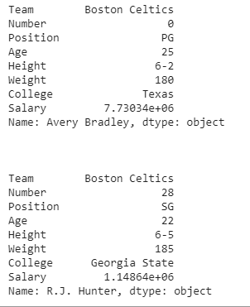
Pandas – DataFrames
Retrieving a player’s information
>> Import pandas as pd
>> data = pd.read_csv(“nba.csv”, index_col=“Name”)
>> first = data.loc["Avery Bradley"]
>> second = data.loc["R.J. Hunter"]
>> print(first)
>> print(second)

Slide 38
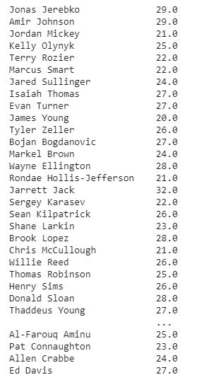
Pandas – DataFrames
Retrieving a single column
>> Import pandas as pd
>> data = pd.read_csv(“nba.csv”, index_col=“Name”)
>> first = data[“Age”]

Slide 39
Pandas – DataFrames
How can we print the entire dataframe?
for i, j in df.iterrows():
print(i, j)

Slide 40
Pandas – Missing values
To check if there are any missing values
import pandas as pd
import numpy as np
dict1 = {'First Score':[100, 90, np.nan, 95], 'Second Score': [30, 45, 56, np.nan], 'Third Score':[np.nan, 40, 80, 98]}
df = pd.DataFrame(dict1)
df.isnull()

Slide 41
Pandas – Fill Missing Values
dict1 = {'First Score':[100, 90, np.nan, 95], 'Second Score': [30, 45, 56, np.nan], 'Third Score':[np.nan, 40, 80, 98]}
df = pd.DataFrame(dict1)
df.fillna(0)

Slide 42
Pandas – Drop the rows with missing values
dict1 = {'First Score':[100, 90, np.nan, 95], 'Second Score': [30, 45, 56, np.nan], 'Third Score':[np.nan, 40, 80, 98]}
df = pd.DataFrame(dict1)
df.dropna()

Slide 43
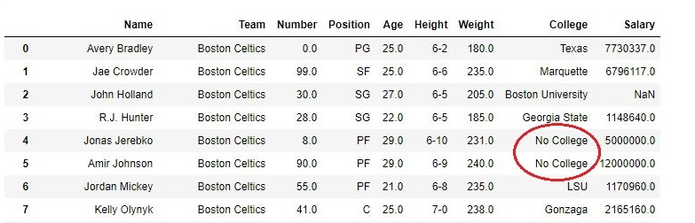
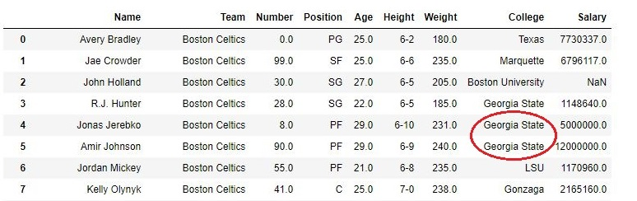
Pandas – ffill()
Missing values are replaced with the previous row’s column value
nba["College"].fillna( method ='ffill', inplace = True)

Slide 44
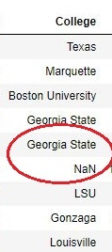
Pandas – ffill()
We can set a limit (by using limit) on successful replacement of NaN values.
nba["College"].fillna( method ='ffill', limit = 1, inplace = True)

Slide 45
Pandas – Groupby()
It is used to split the data into groups based on some criteria.
For example, use the nba.csv to group the data based on the “Team”
>> import pandas as pd
>> df = pd.read_csv("nba.csv")
>> df
>> gbdata = df.groupby(‘Team’)
>> gbdata.first()
>> gbmean = df.groupby(‘age’).mean()
>> gbmean

Slide 46
Summary of the dataframe
>> print(df.info())

Slide 47
Pandas – Class Exercise
How can we retrieve a row by their index number? For example, index=3?
How do you find the number of rows and number of columns in the dataframe?
For nba.csv dataset, find the number of rows that have missing values.
Replace all the missing values in nba.csv with 0.

Slide 48
What is data?
Attributes
Collection of data objects and their attributes
According to Tan et al.,
An attribute is a property or characteristic of an object
Also known as variable, field, characteristic, dimension, or feature
A collection of attributes describe an object
Also known as tuple, record, point, case, sample, etc.
Objects

Slide 49
More views of data
Data may have parts
The different parts of data may have relationships
More generally, data may have structure
Data can be incomplete

Slide 50
Attribute values
Attribute values are numbers or symbols assigned to an attribute for a particular object
Distinction between attributes and attribute values
Same attribute can be mapped to different attribute values
Example: Height can be measured in feet or meters
Different attributes can be mapped to the same set of values
Example: Attribute values for ID and age are integers
But properties of attribute values can be different

Slide 51
Types of Attributes
Nominal
Examples: ID numbers, zip codes, eye color
Ordinal
Examples: Rankings (expertise level on a scale of 1-10), grades, height {tall, medium, short}
Interval
Examples: Calendar dates, temperature in Celsius or Fahrenheit
Ratio
Examples: Temperature in Kelvin, length, time, counts

Slide 52
Discrete and Continuous attributes
Discrete Attribute:
Has only a finite or countably infinite set of values
Examples: zip codes, counts, or the set of words in a collection of documents
Often represented as integer variables.
Note: binary attributes are a special case of discrete attributes
Continuous Attribute:
Has real numbers as attribute values
Examples: temperature, height, or weight.
Practically, real values can only be measured and represented using a finite number of digits.
Continuous attributes are typically represented as floating-point variables.

Slide 53
Types of datasets
Record
Data Matrix
Document Data
Transaction Data
Graph
World Wide Web
Molecular Structures
Ordered
Spatial Data
Temporal Data
Sequential Data
Genetic Sequence Data

Slide 54
Important characteristics of data
Dimensionality (number of attributes)
High dimensional data brings a number of challenges
Sparsity
Only presence counts
Resolution
Patterns depend on the scale
Size
Type of analysis may depend on size of data

Slide 55
Record data
Data that consists of a collection of records, each of which consists of a fixed set of attributes

Slide 56
Document data
Each document becomes a ‘term’ vector
Each term is a component (attribute) of the vector
The value of each component is the number of times the corresponding term occurs in the document.

Slide 57
Transaction data
A special type of record data, where
Each record (transaction) involves a set of items.
For example, consider a grocery store. The set of products purchased by a customer during one shopping trip constitute a transaction, while the individual products that were purchased are the items.

Slide 58
Graph Data
Examples: Generic graph, a molecule, and webpages
Benzene Molecule: C6H6

Slide 59
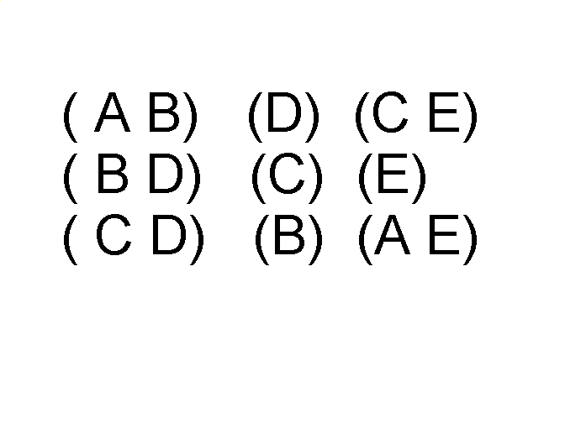
Ordered Data
Items/Events
Sequences of transactions
An element of the sequence

Slide 60
Ordered Data
Genomic sequence data

Slide 61
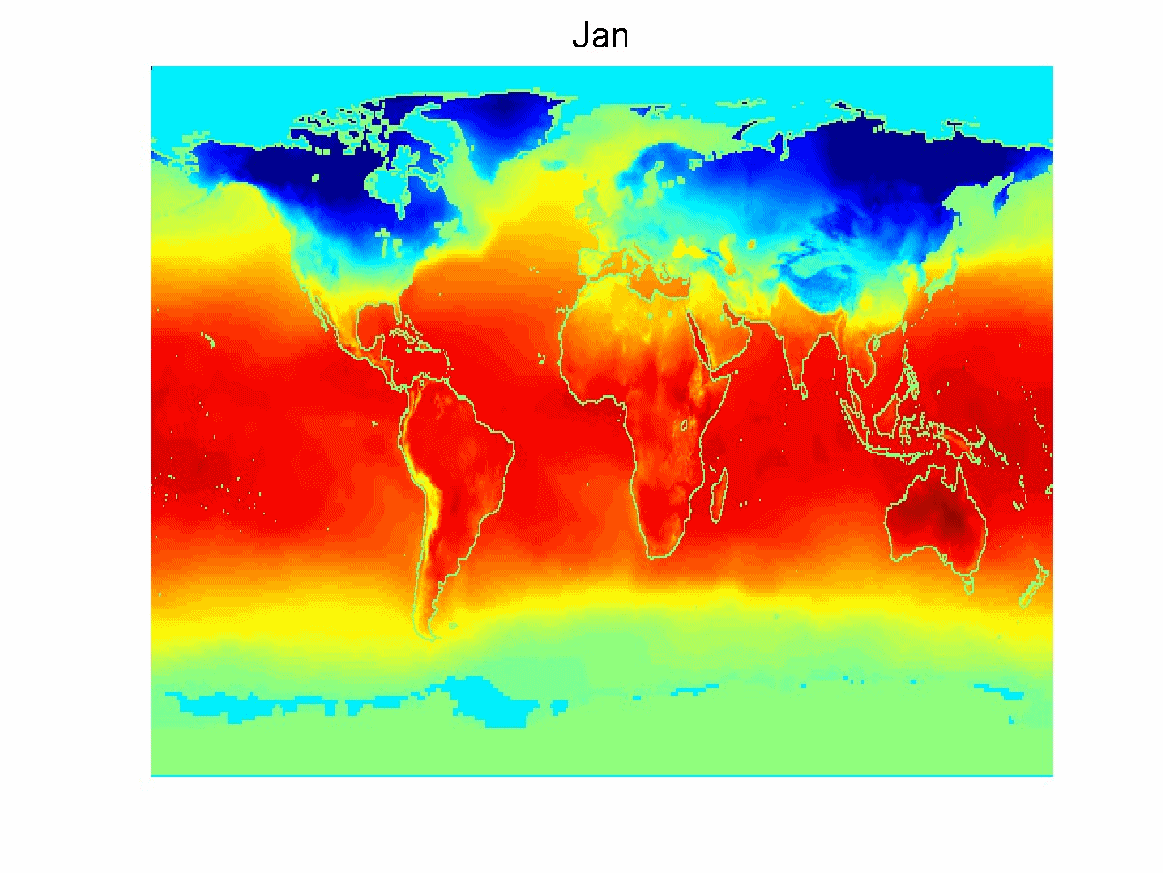
Ordered Data
Spatio-temporal data
Average Monthly Temperature of land and ocean

Slide 62
Examples
ID numbers
Nominal, ordinal, or interval?
Number of cylinders in an automobile engine
Nominal, ordinal, or ratio?
Biased Scale
Interval or Ratio

Slide 63
Data Preprocessing
Aggregation
Sampling
Dimensionality Reduction
Feature subset selection
Feature creation
Discretization and Binarization
Attribute Transformation

Slide 64
Aggregation
Combining two or more attributes (or objects) into a single attribute (or object)
Purpose
Data reduction
Reduce the number of attributes or objects
Change of scale
Cities aggregated into regions, states, countries, etc.
Days aggregated into weeks, months, or years
More “stable” data
Aggregated data tends to have less variability

Slide 65
Example: Precipitation in Australia
This example is based on precipitation in Australia from the period 1982 to 1993.
The next slide shows
A histogram for the standard deviation of average monthly precipitation for 3,030 0.5◦ by 0.5◦ grid cells in Australia, and
A histogram for the standard deviation of the average yearly precipitation for the same locations.
The average yearly precipitation has less variability than the average monthly precipitation.
All precipitation measurements (and their standard deviations) are in centimeters.

Slide 66
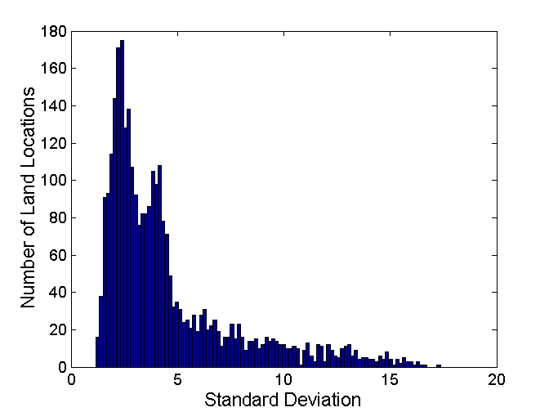
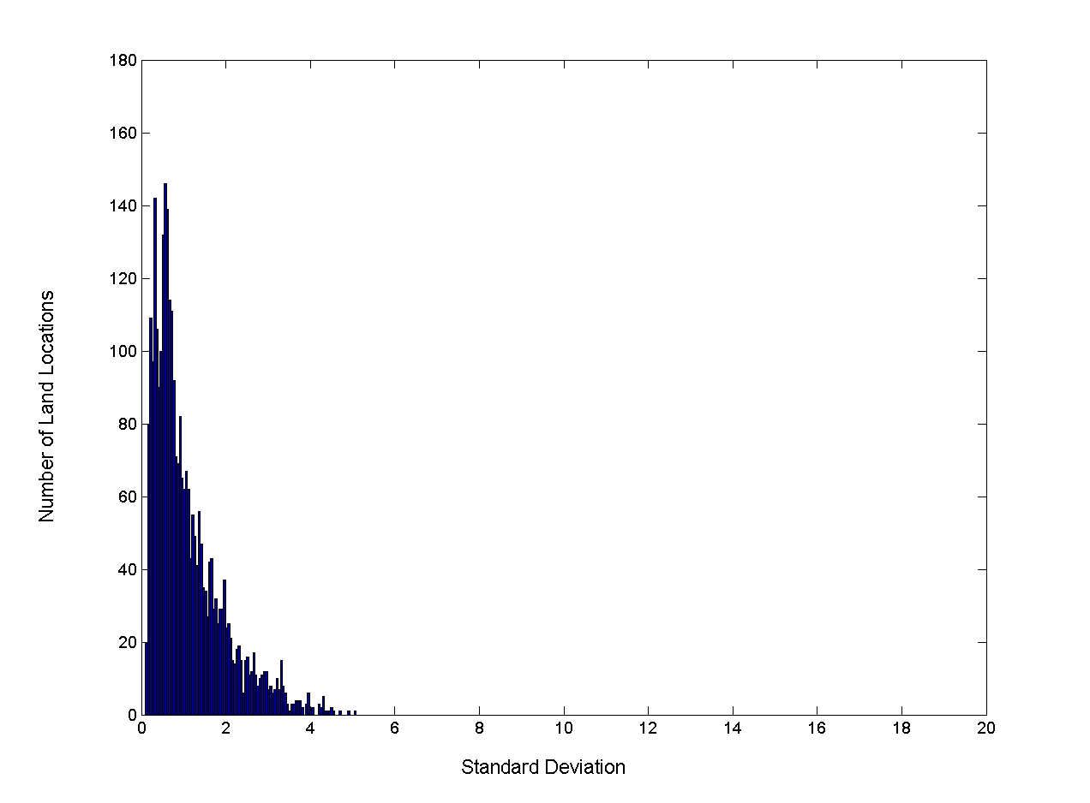
Example: Precipitation in Australia..
Variation of precipitation in Australia
Standard Deviation of Average Monthly Precipitation
Standard Deviation of Average Yearly Precipitation

Slide 67
Sampling
Sampling is the main technique employed for data reduction.
It is often used for both the preliminary investigation of the data and the final data analysis.
Statisticians often sample because obtaining the entire set of data of interest is too expensive or time consuming.
Sampling is typically used in data mining because processing the entire set of data of interest is too expensive or time consuming.

Slide 68
Sampling
The key principle for effective sampling is the following:
Using a sample will work almost as well as using the entire data set, if the sample is representative
A sample is representative if it has approximately the same properties (of interest) as the original set of data

Slide 69

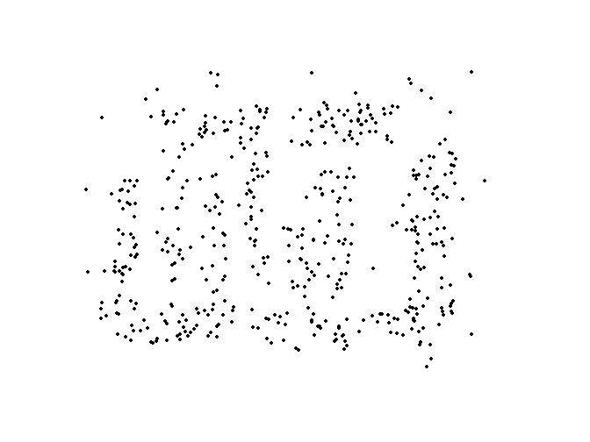
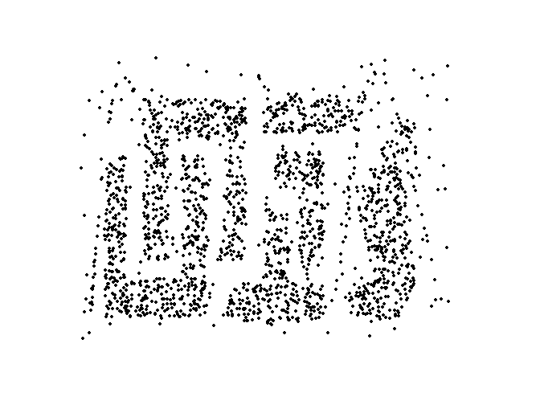
Sample size
8000 points 2000 Points 500 Points

Slide 70
Types of Sampling
Simple Random Sampling
There is an equal probability of selecting any particular item
Sampling without replacement
As each item is selected, it is removed from the population
Sampling with replacement
Objects are not removed from the population as they are selected for the sample.
In sampling with replacement, the same object can be picked up more than once
Stratified sampling
Split the data into several partitions; then draw random samples from each partition

Slide 71
Curse of dimensionality
When dimensionality increases, data becomes increasingly sparse in the space that it occupies

Slide 72
Dimensionality Reduction
Purpose:
Avoid curse of dimensionality
Reduce amount of time and memory required by data mining algorithms
Allow data to be more easily visualized
May help to eliminate irrelevant features or reduce noise
Techniques
Principal Components Analysis (PCA)
Singular Value Decomposition
Others: supervised and non-linear techniques

Slide 73
Feature subset Selection
Another way to reduce dimensionality of data
Redundant features
Duplicate much or all of the information contained in one or more other attributes
Example: purchase price of a product and the amount of sales tax paid
Irrelevant features
Contain no information that is useful for the data mining task at hand
Example: students' ID is often irrelevant to the task of predicting students' GPA
Many techniques developed, especially for classification

Slide 74
Feature Creation
Create new attributes that can capture the important information in a data set much more efficiently than the original attributes
Three general methodologies:
Feature extraction
Example: extracting edges from images
Feature construction
Example: dividing mass by volume to get density
Mapping data to new space
Example: Fourier and wavelet analysis

Slide 75
Discretization
Discretization is the process of converting a continuous attribute into an ordinal attribute
A potentially infinite number of values are mapped into a small number of categories
Discretization is commonly used in classification
Many classification algorithms work best if both the independent and dependent variables have only a few values

Slide 76
Binarization
Binarization maps a continuous or categorical attribute into one or more binary variables
Typically used for association analysis
Often convert a continuous attribute to a categorical attribute and then convert a categorical attribute to a set of binary attributes
Association analysis needs asymmetric binary attributes
Examples: eye color and height measured as {low, medium, high}

Slide 77
Attribute Transformation
An attribute transform is a function that maps the entire set of values of a given attribute to a new set of replacement values such that each old value can be identified with one of the new values
Simple functions: x^{k}, log(x), e^{x}, |x|
Normalization
Refers to various techniques to adjust to differences among attributes in terms of frequency of occurrence, mean, variance, range
Take out unwanted, common signal, e.g., seasonality
In statistics, standardization refers to subtracting off the means and dividing by the standard deviation

Slide 78
Seaborn
Python library to generate good graphs that provide lot of insights

Slide 79
In-class Case

Slide 80
Iris dataset
Use this dataset to perform different preprocessing techniques to understand the dataset.
At the end of this exercise, every team should submit their best visualization and a small description why it is good at explaining the data on Piazza thread.

